Slide 1
connect two or more networks with a router in each network and configure the routers for static routing
Practical
Software required: Cisco Packet Tracer

Slide 2
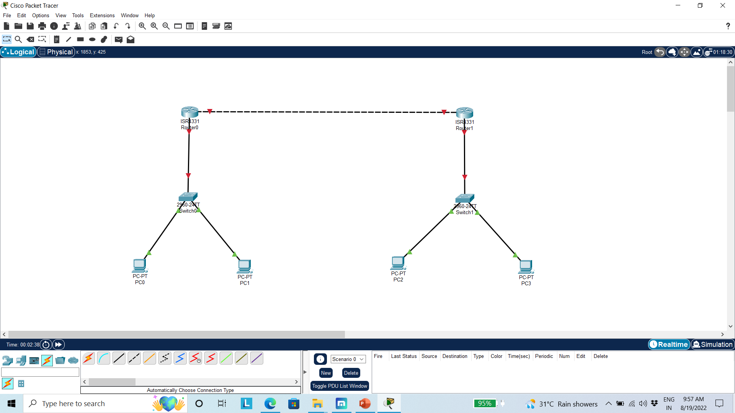
Design

Slide 3
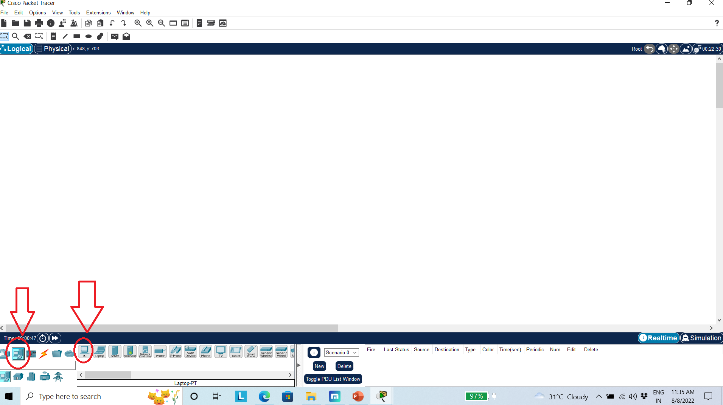
Step 1: Open Cisco Packet Tracer Tool Step 2: Select Proper option two design requires Network

Slide 4
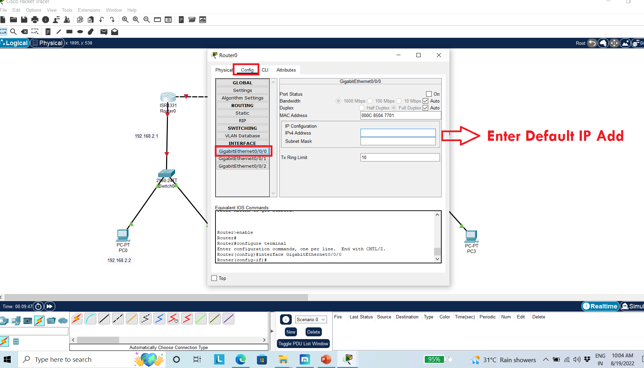
Step 3: Select the proper device and configure them Step 4: Set IP Address to PC and Connection Step 5: Go to Router –Conf-

Slide 5
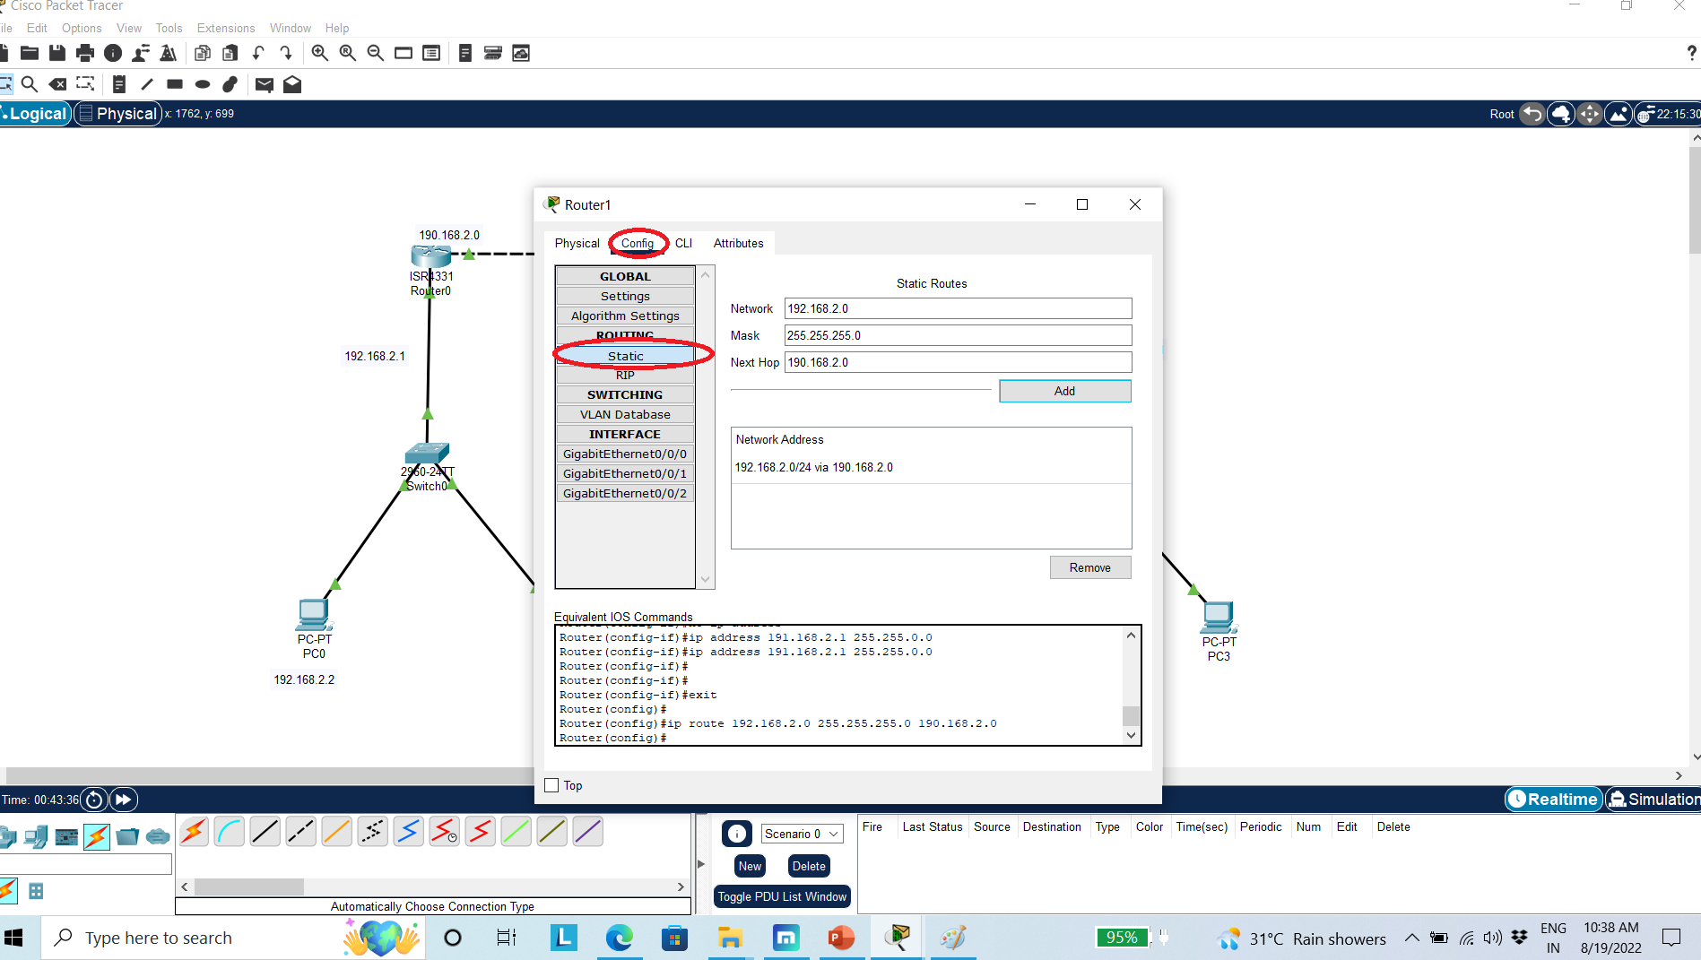
Step 6: Configure Static Router

Slide 6
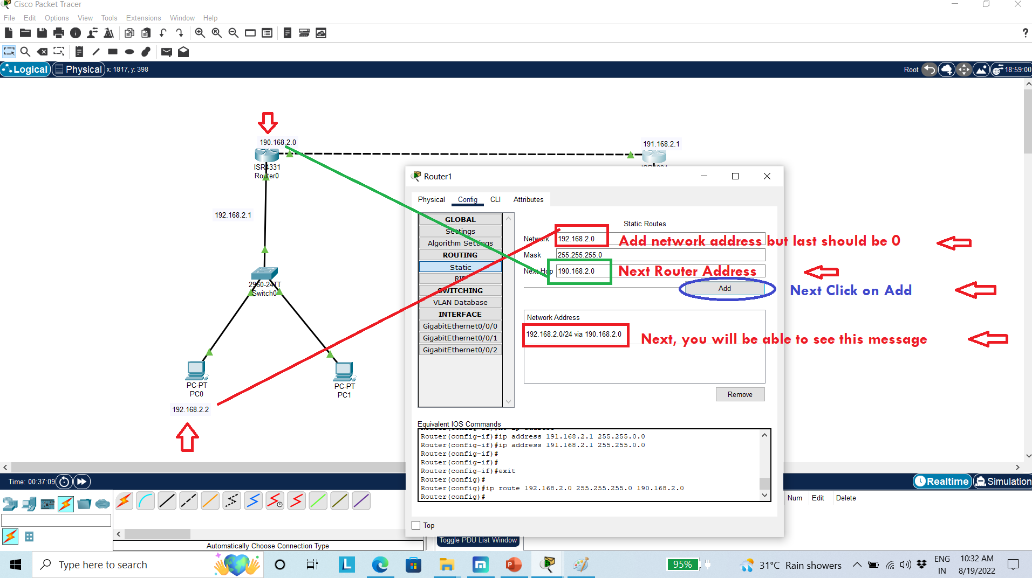
Configure static router

Slide 7
